Slide 1
Bitcoin Price Prediction Based on
CNN-LSTM Hybrid Neural Network Model
Bitcoin Price Prediction Based on
CNN-LSTM Hybrid Neural Network Model
Group Members： Li Yan
Han Yuyao
Liu Xiaojuan
Li Xin
Zhu Jiatong

Slide 2
CONTENTS
01
02
Background and Related Literature
Model Construction
03
04
Empirical Research
Innovation and Improvement

Slide 3

01
Background and Related Literature

Slide 4

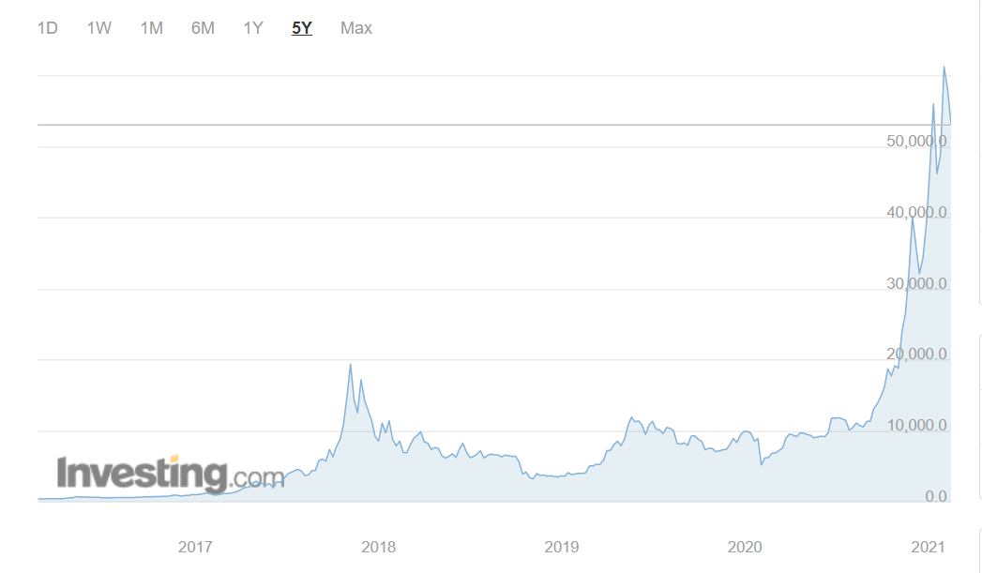
In April 2010, Bitcoin was first publicly traded at a price of only $0.03, and in January 2013 The price still did not exceed $15, and the peak price in December of the same year was close to US $1000. Moreover, in December 2017, the price reached a new high of $19,000 but then fell sharply to $6,700 in February 2018 and even reached at $3,200 in December at the same year. At the end of 2018, after the price of Bitcoin went through a low ebb, the price rose all the way and was in a state of rapid growth, exceeding $61000 in March 2021. Recently, Bitcoin has its best first quarter since 2013, spending more than 30 days above $50,000 for the first time in its history.

Slide 5
Factors affecting the price
Ladislav Kristoufek
2013
Cheoljun Eom and Taisei Kaizoji 2019
S.Vassiliadis
2017
Huang JZ
2018
There is a relationship between Bitcoin price and search engine. Additionally, the price of Bitcoin would be affected by investors’ speculative behavior, and there is a bubble in it.
There is a strong correlation between the price of Bitcoin and trading volume and transaction cost, and there is a certain relationship with gold, crude oil and stock market index.
They used 124 technical indicators based on the historical price of Bitcoin to build a return prediction model, showing that the combination of big data and technical analysis can help predict the return of Bitcoin.
Investor sentiment can help explain changes in Bitcoin volatility for future periods significantly.

Slide 6
Deep Learning Technology
Dennys C.A.Mallquia
2018
Liang qiu
2015
Li Jing
2016
Introduce the wavelet analysis to the prediction of the trend of Bitcoin price over a quarter, using the time series of Bitcoin price
Establishing a Bitcoin market forecasting model which uses the data of the previous day, week and month of Bitcoin market on the BP neural network
The combination of RNN and a Tree classifier can better predict the direction of Bitcoin price, meanwhile SVM algorithm obtains a more precise prediction than ANN in forecasting the Bitcoin price.

Slide 7
02
Model Construction

Slide 8

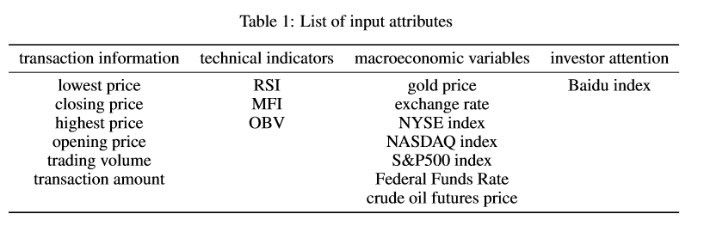
Data Collection and Pre-processing
To prevent the influence of different dimensions of the original variables on the prediction accuracy, the original data is standardized.
The transaction information is from Kraken Bitcoin Trading Platform.
LSTM PART
Huang JZ(2018) declared that technical indicators can be used to predict the price of Bitcoin. (Predicting Bitcoin Returns Using High Dimensional Technical Indicators)
The Internet Finance Laboratory of Tsinghua University's Wudaokou School of Finance (Global Bitcoin Research Report 2014—2016), China accounts for 80 percent of the world's Bitcoin transactions

Slide 9
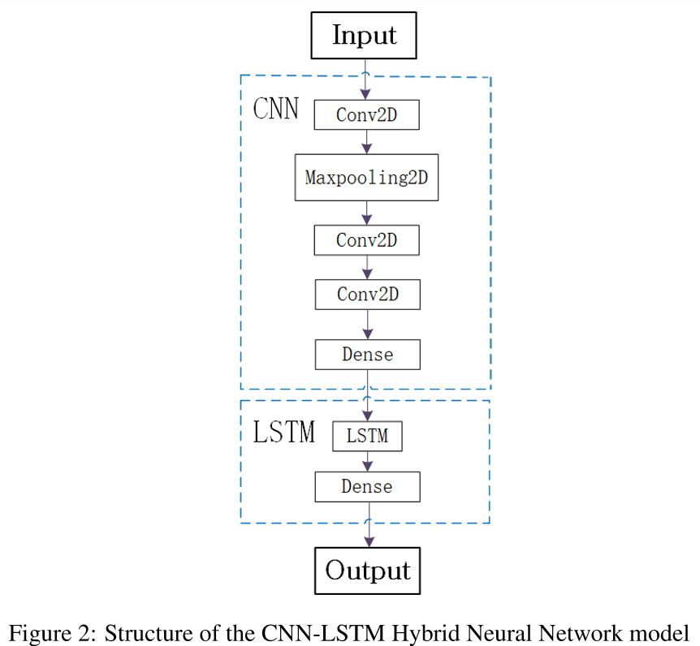
CNN-LSTM Hybrid Neural Network
CNN PART
The input is a feature graph with the size of 3*17. The number of the convolution kernels are all 15, and sizes of them are also the same of 2*2.
Dense extracts the characteristic data as a one- dimensional vector array whose length is 25.
LSTM PART
The number of hidden layer nodes is 50 and the learning rate is 0.01.
MSE is used as the loss function and Adam is used as the optimization method.
The number of iterations is set to 100, and the size of training batch is 50.

Slide 10
03
Empirical Research

Slide 11
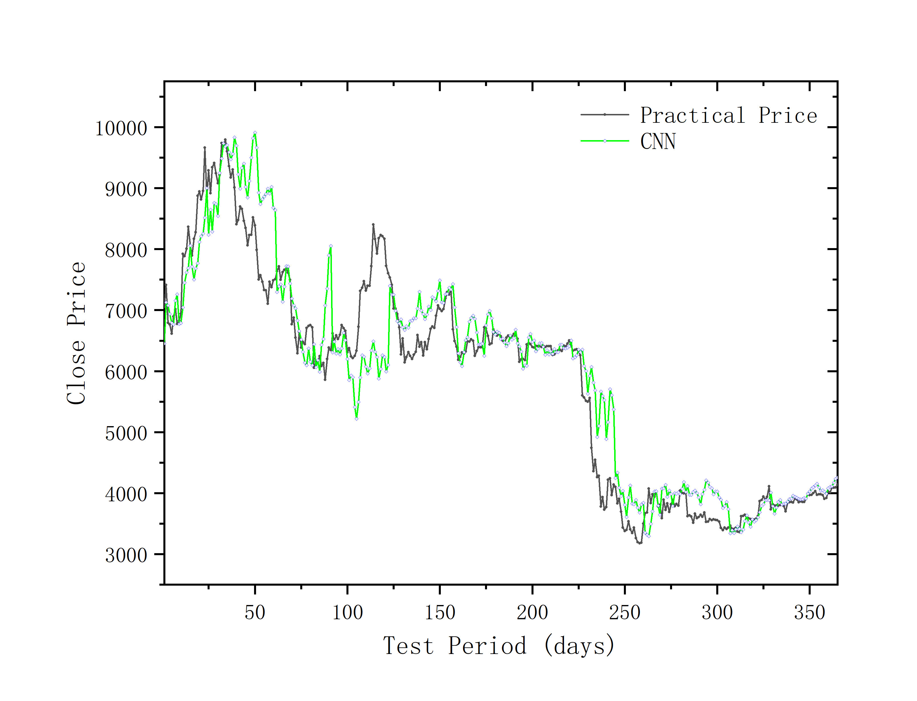
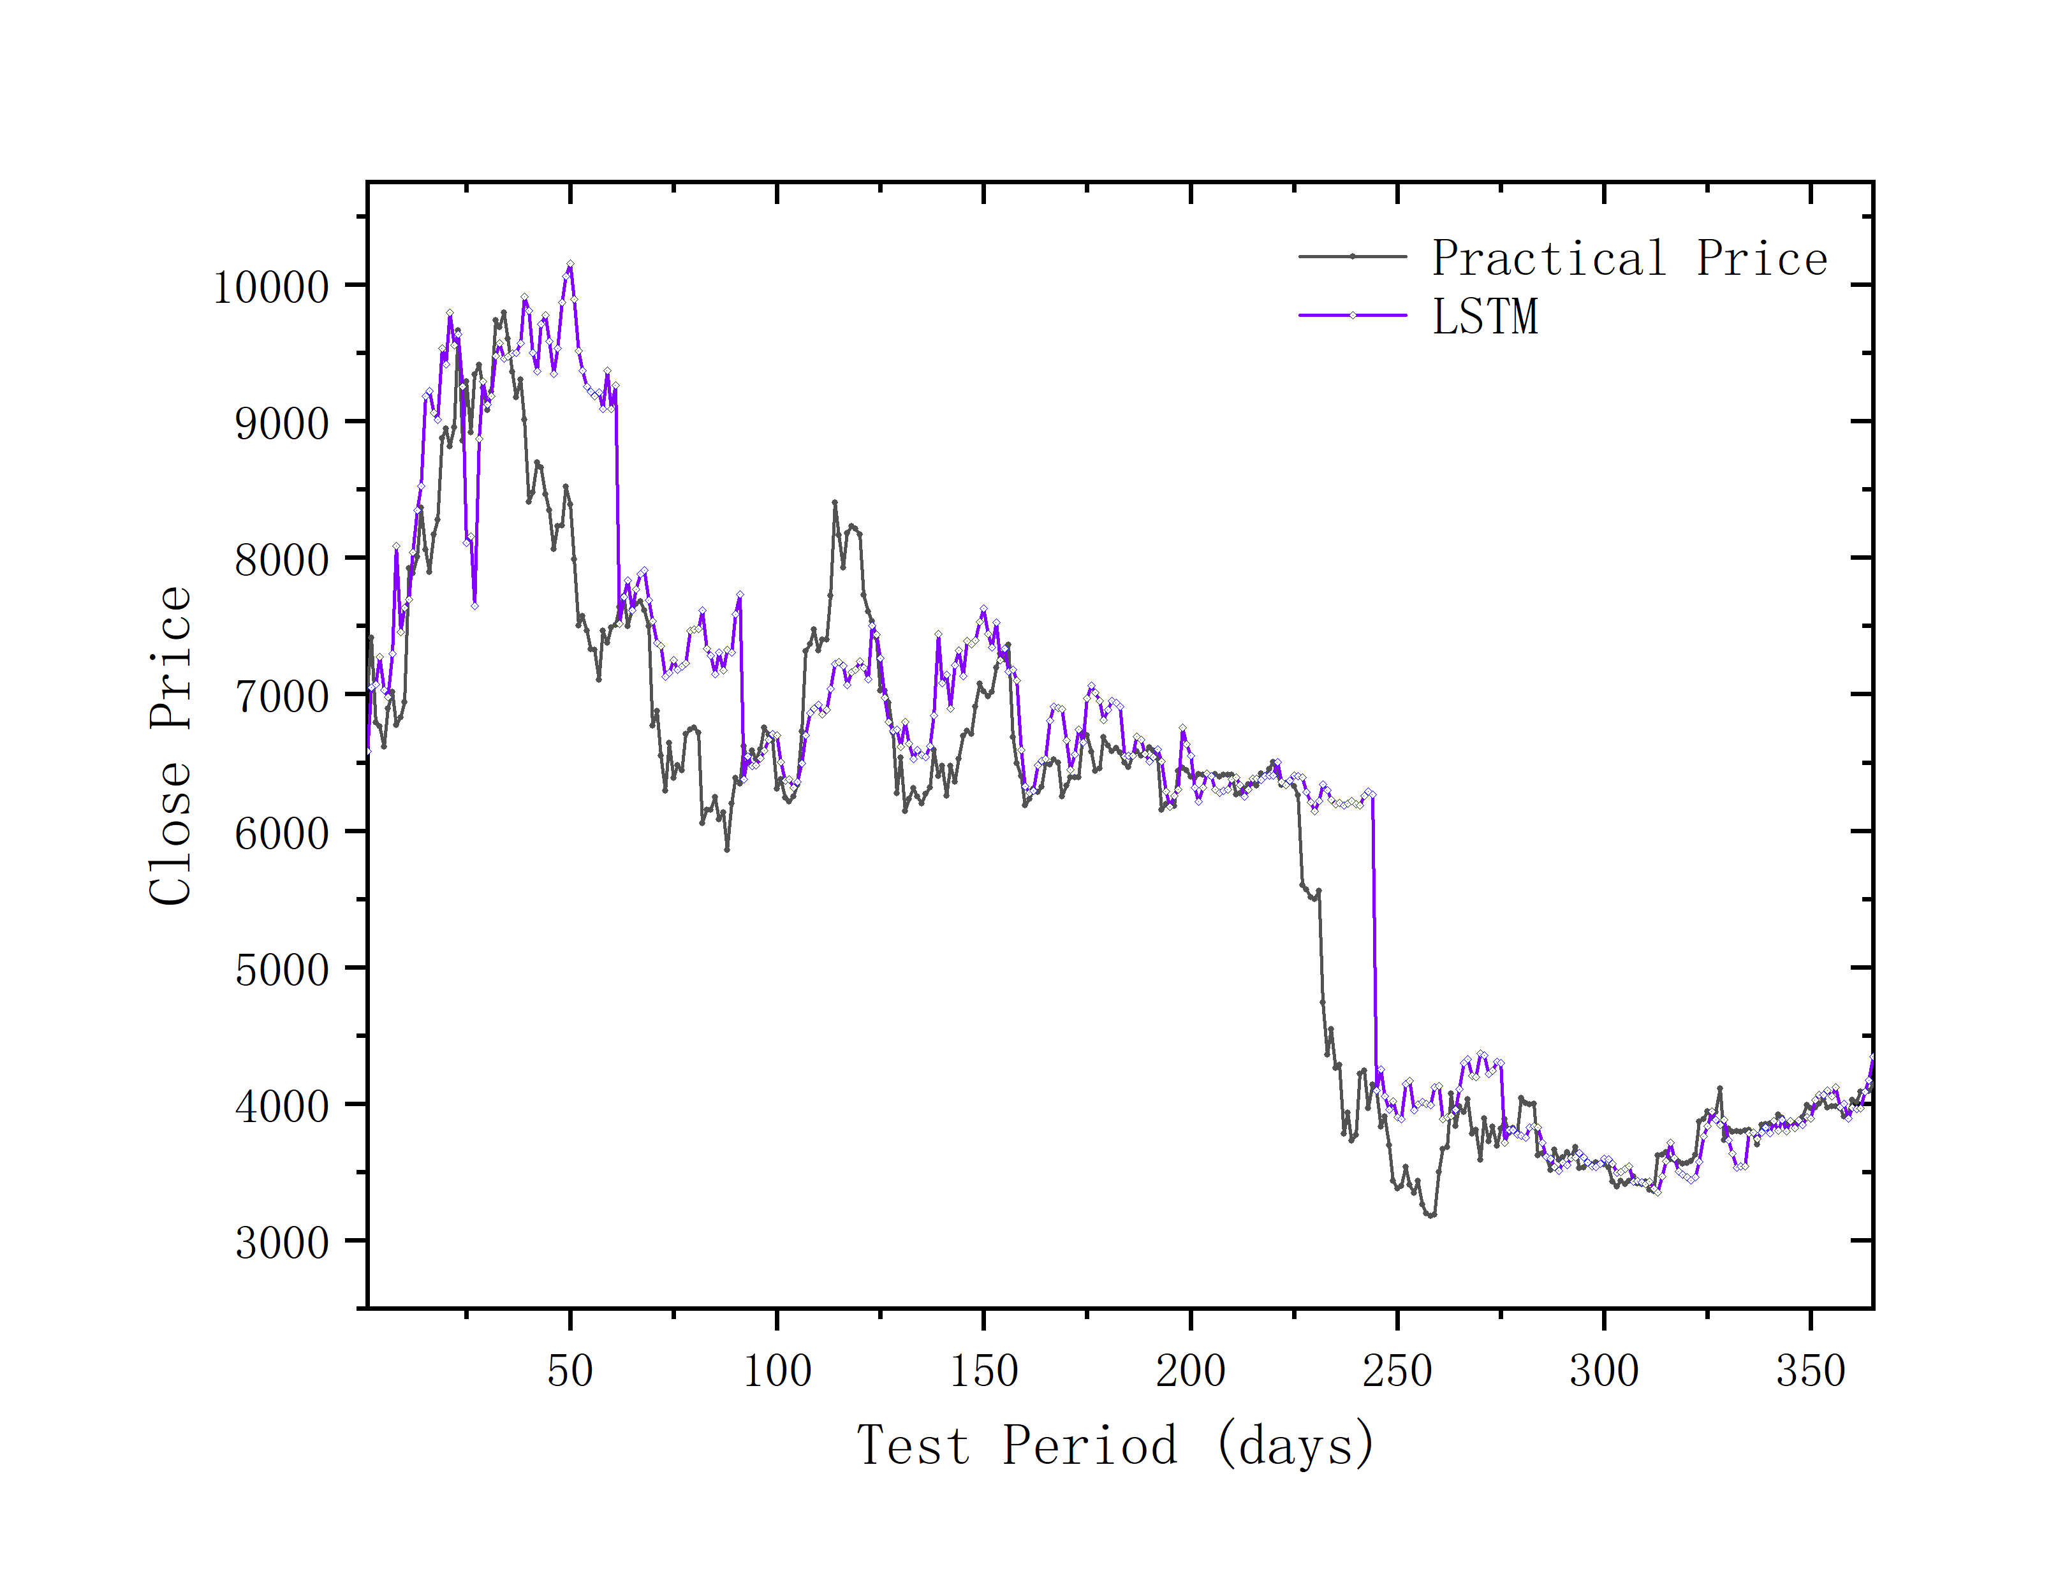
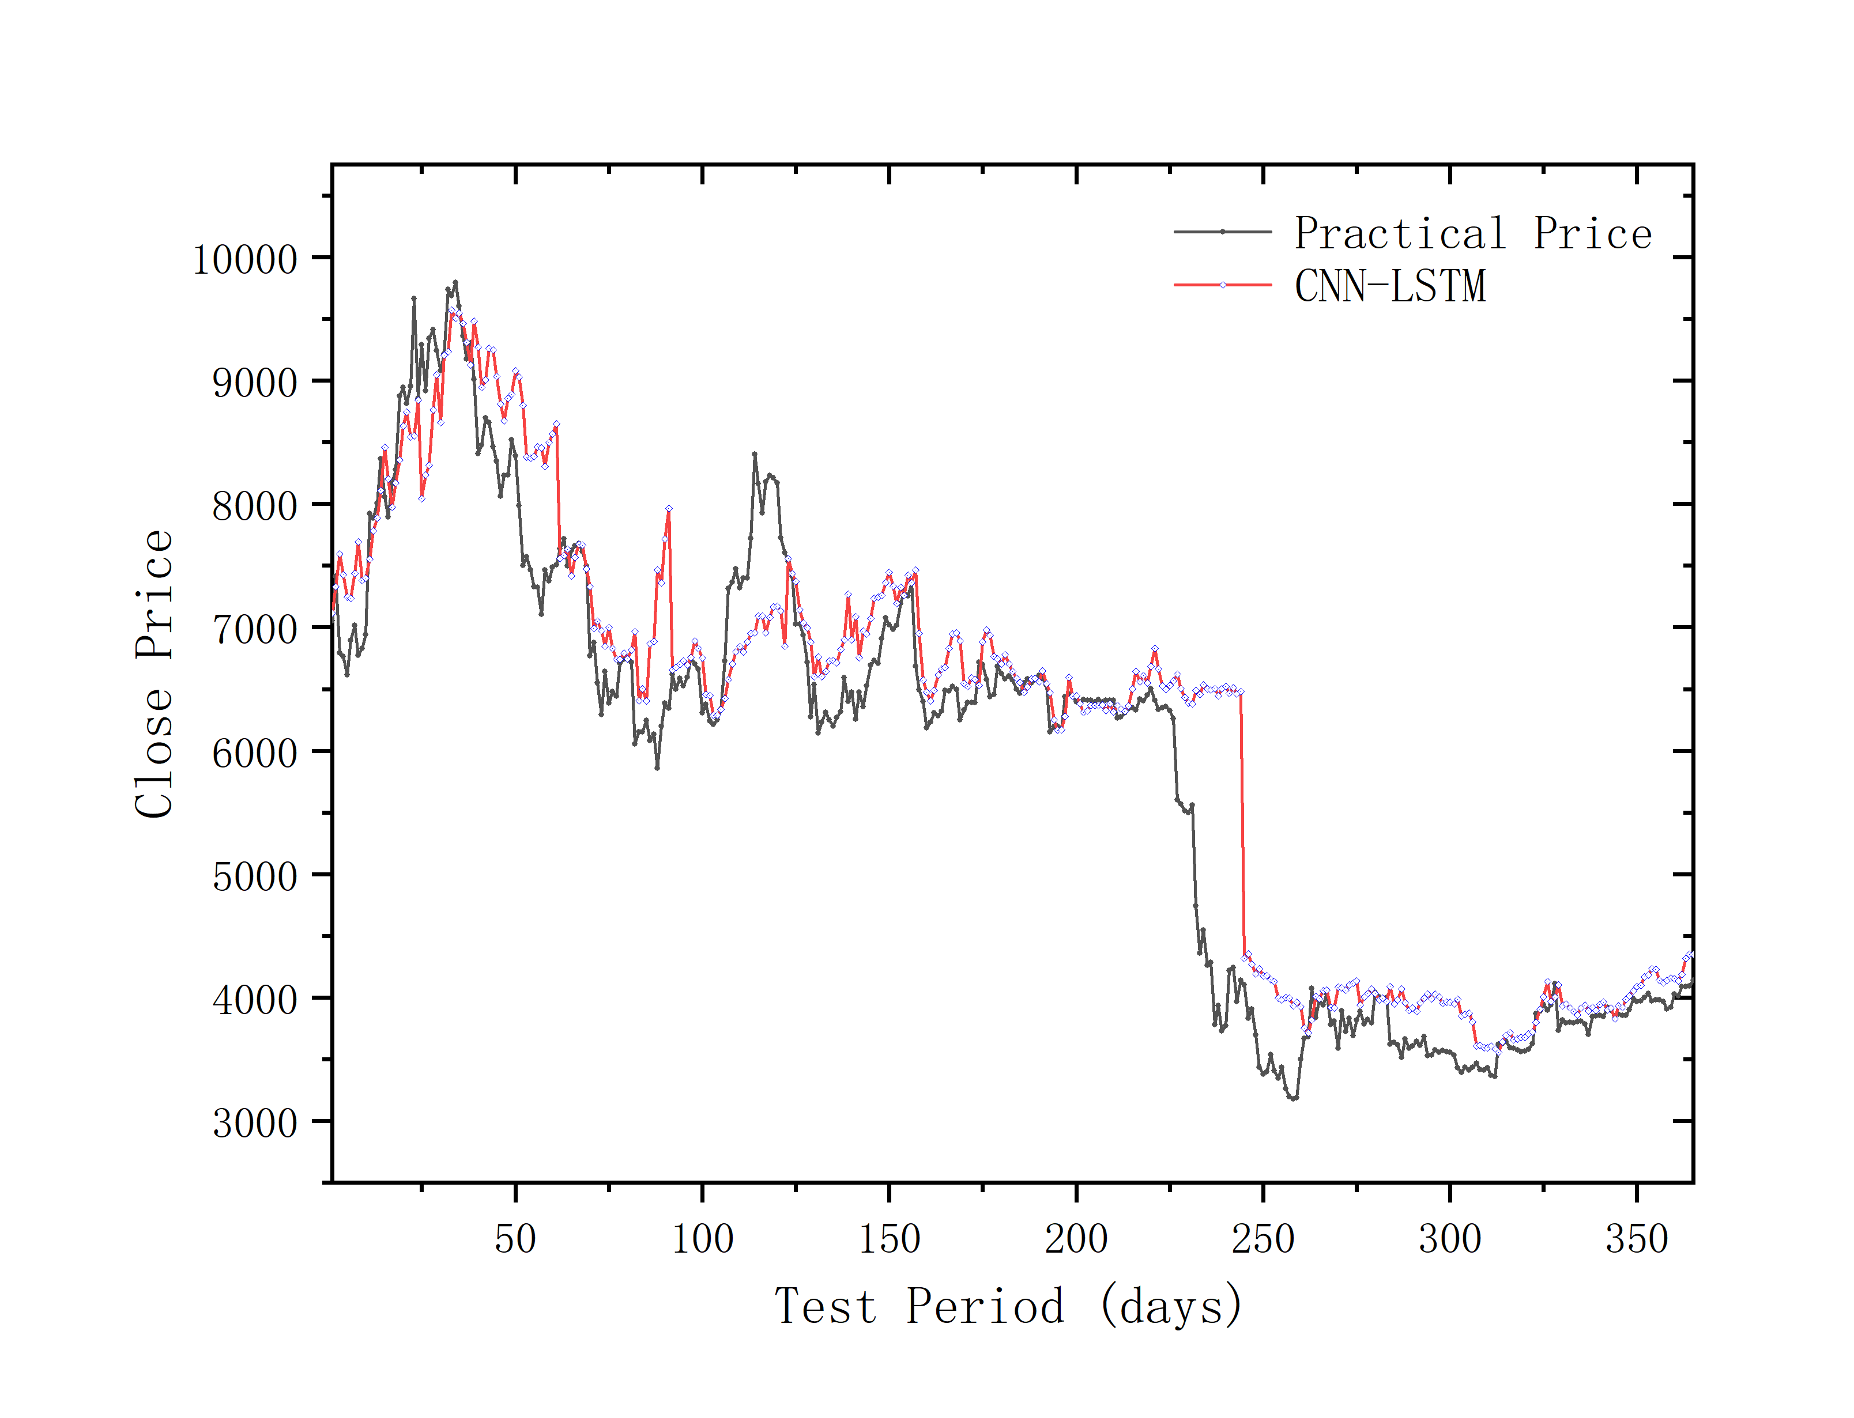
Comparison diagram
The dates of all data in this paper range from October 30th, 2017 to April 1st, 2019.
Rolling prediction method— the data from the first five months is used as a training set to predict the next month.
The characteristic parameter data of the previous 3 days is used to predict the closing price of Bitcoin on the 4th day.

Slide 12
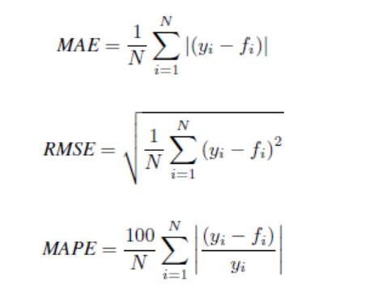
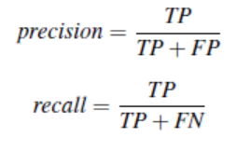
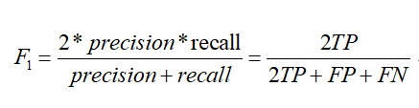
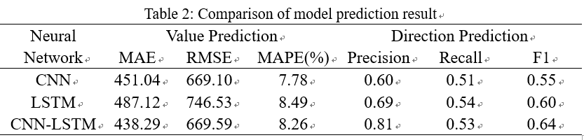
Comparison of model prediction result

Slide 13
04
Innovation and Improvement

Slide 14
Innovation and Improvement
INNOVATION
Our project not only considers Bitcoin’s own transaction information, but also includes external factors such as macroeconomic variables and investor’s attention, comprehensively employing various factors that may affect Bitcoin prices.
Introduced artificial intelligence technology into Bitcoin price prediction and propose CNN-LSTM Hybrid Neural Network. CNN is used to extract the characteristics that have a great influence on Bitcoin price in the data set, and then LSTM is used for price forecasting.
IMPROVEMENT
Incorporate the popularity of Bitcoin on other but worldwide social software, such as Twitter and Instagram into the data to quantify investor attention.

Slide 15
Thanks !

